Slide 1

REAL LIFE LAB(RLL) GROUP-IV

Slide 2

INSURANCE POLICY MANAGEMENT

Slide 3

Team Lead : Members :
Kaviya X
Kartik Goyal Keerthika S Kesavini R
Koppuravuri Gayatri Lakshmi Kshitiz Gupta
Logeshwaran S
Logeswaran Mohanraj
M Mohanraj
Mahanandigari Bhaskar Reddy

Slide 4

PROJECT OVERVIEW
Create a dynamic and responsive web application for managing the insurance policies application online.

Slide 5

OBJECTIVES
To provide a bug-free application to the policy maker (Admin) as well as the customer,
The main objective is to build a secured, robust insurance management system where the policies are managed properly.
It maintains the record of customers, policies, buyers policies efficiently so that it would be easy to access at any time 24*7.

Slide 6




TOOLS AND TECHNOLOGIES
Backend :- JPA, Java, Springboot
Frontend :- Angular, HTML, Boostrap, CSS
Server :- Tomcat
Database :- MySql

Slide 7
PROJECT REQUIREMENTS
EclipseIDE to handle backend.
JDK : To run this project you have above 1.8 version.
Tomcat 9: This project runs over tomcat 9 server.
MYSQL : You need MYSQL database for running this project.
MYSQL J Connector : For making the connection from MYSQL and Java, we need it.
Angular CLI : For running the angular project for frontend.
SpringBoot : For running the springboot project for backend.

Slide 8
IMPLEMENTATION
ANGULAR IMPLEMENTATION
Angular is used to develop the frontend application. As a framework, Angular has clear advantages while also providing a standard structure for developers to work with. Angular is a frontend framework that allows developers to write once and deploy to multiple platforms.
SPRINGBOOT IMPLEMENTATION
Springboot is used perform the backend application. It is used to develop the API and operations like add, update, delete and view and connecting to MYSQL database.

Slide 9
INSURANCE POLICY –FLOW CHART
HOMEPAGE
Admin
Customer
About us
Contact us
Registration Page
Login Page
Admin Dashboard
Apply
View All Policy
Contact Admin
Q/A From Admin
Questions
Home
Policies
Create Account
Logout
User Applied Policies
Add policy
Update policy
View policy
Delete policy
Home
Available Policies
Status
Q/A Part

Slide 10
MODULES
Admin Module
Customer Module
Testing
Module
Q & A Module
Customer Policy Dashboard
Admin Policy dashboard

Slide 11
MODULES EXPLANATION
User, admin validation :-
In this module ,we validate admin and user details ,according to their credentials and create the accounts for customers.
Admin policy dashboard :-
On admin dashboard, policies are managed by admin. And the other features are available.
Customer policy dashboard :-
On customer dashboard ,User can access policy and apply and raise queries to admin.

Slide 12
Q/A Module :-
In this Q&A part , Incase any doubts we can contact to admin, regarding queries and raising queries.
Testing :-
In this part , we had done testing, to fix bugs and automate the webpages.

Slide 13
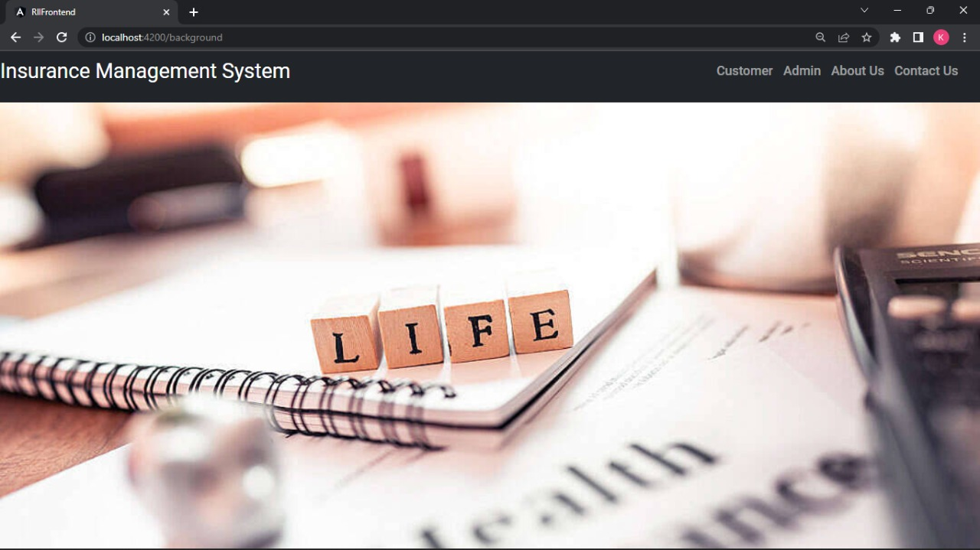
HOME PAGE
Home Page :- Access customer and admin credentials and the information about the insurance policy.

Slide 14
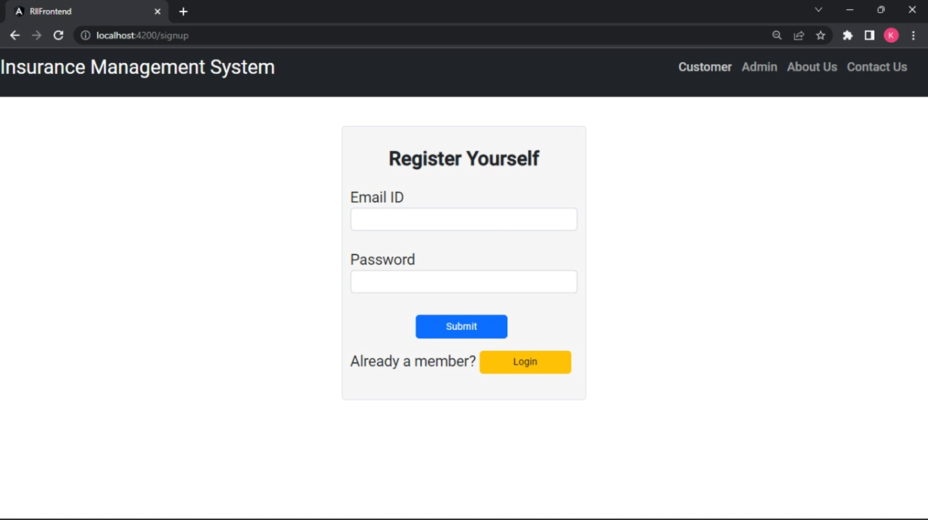
REGISTRATION PAGE
Register Page it is used to create the account for customer to login and apply policies.

Slide 15
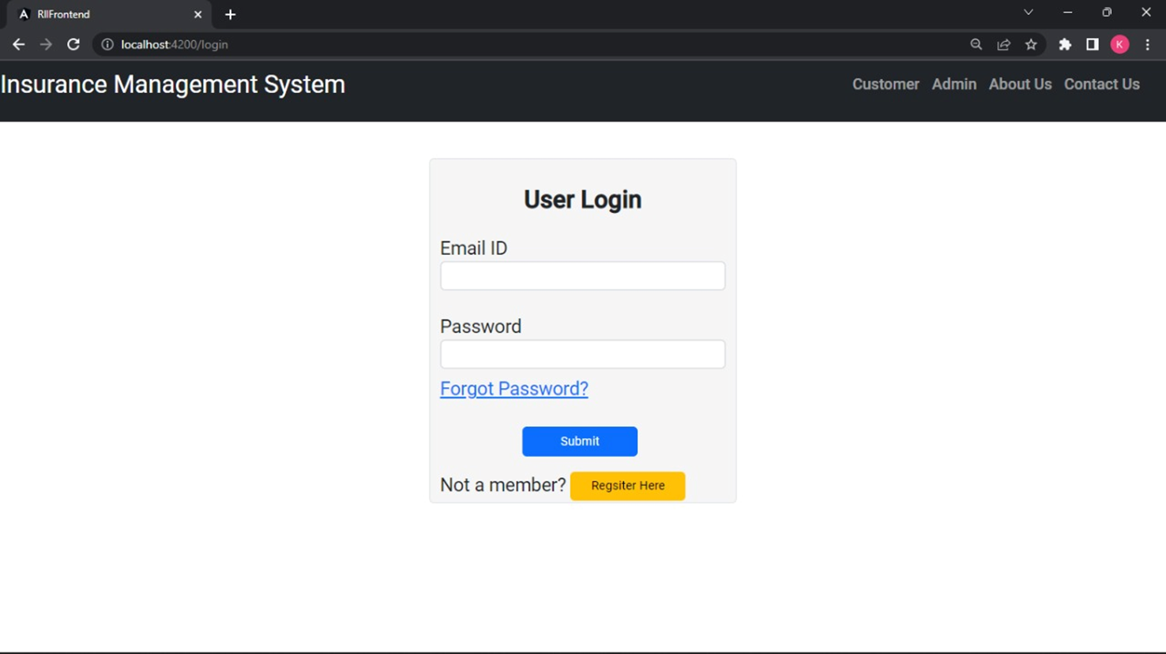
LOGIN PAGE
After create the account you have to login to access the policy page.

Slide 16
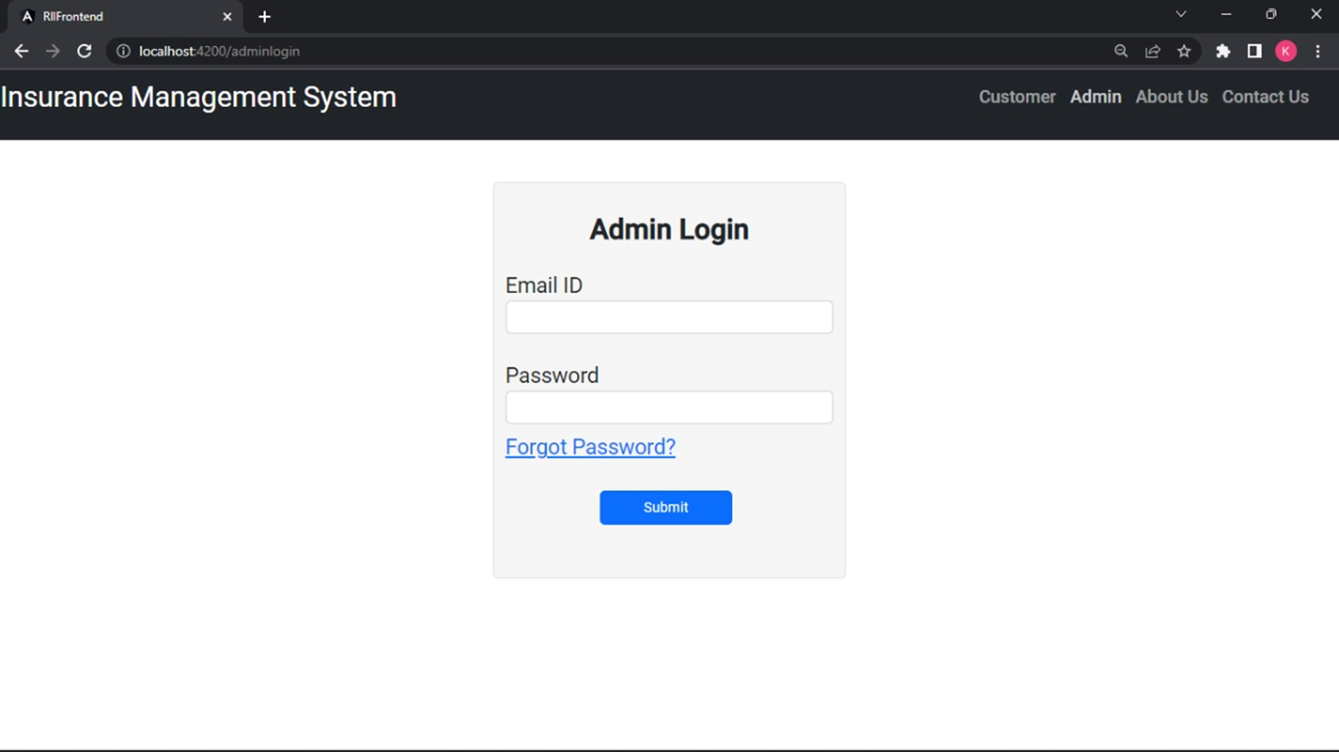
ADMIN LOGIN PAGE
Admin have to login that page not to create the additional account.

Slide 17
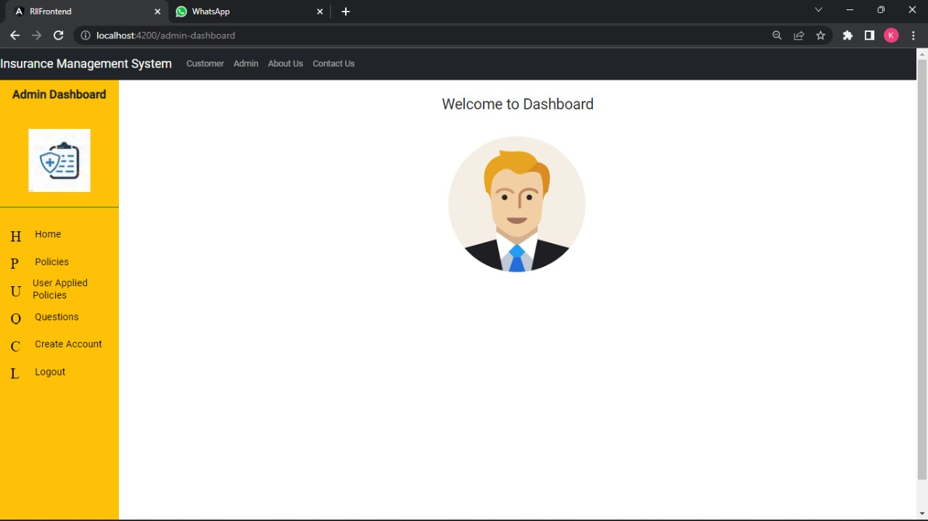
ADMIN POLICY DASHBOARD
Home
Policies
User Applied Policies
Questions
Create Account

Slide 18
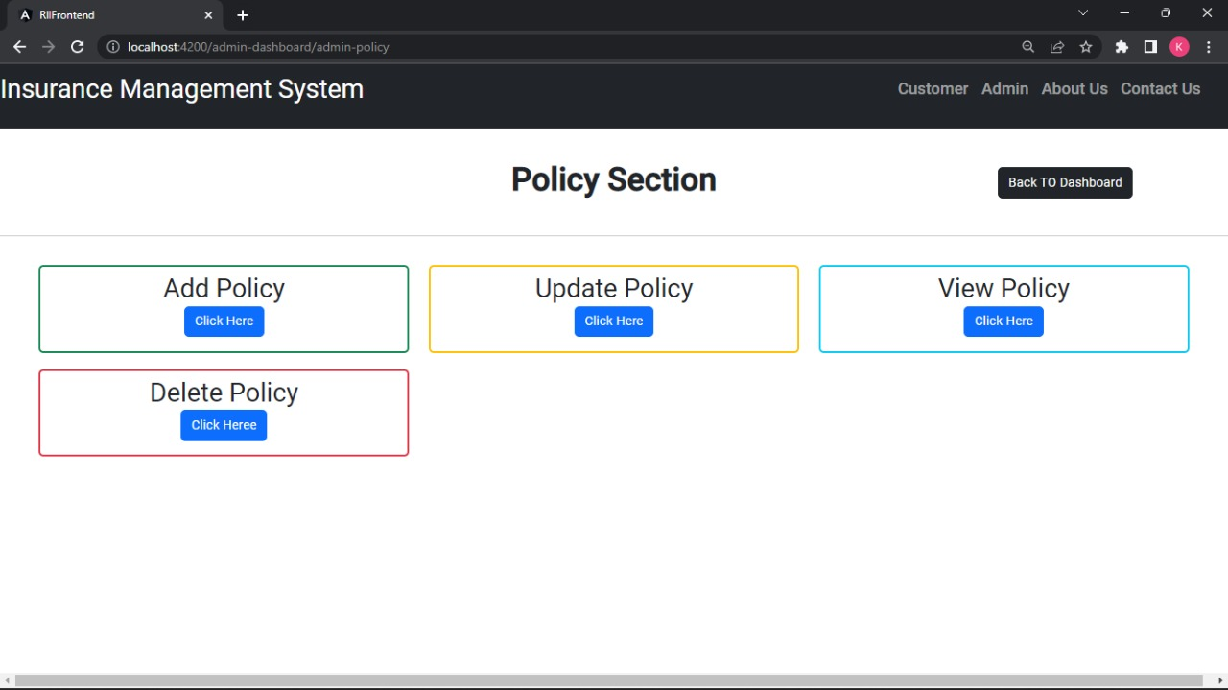
FEATURES OF POLICIES

Slide 19
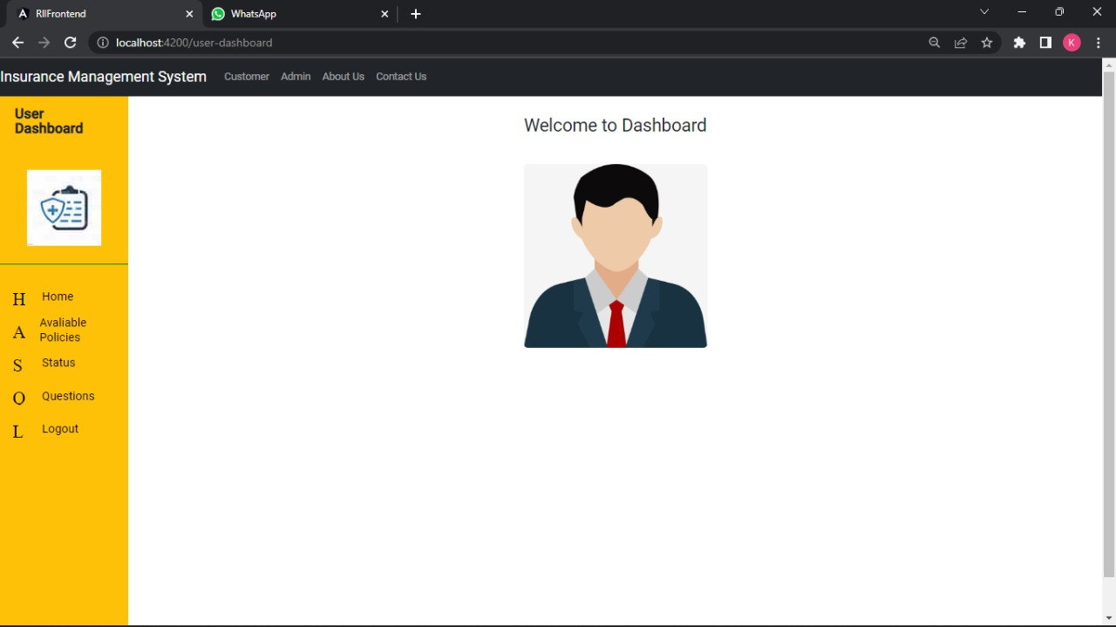
USER POLICY DASHBOARD
Home
Available Policies
Status
Q/A Part

Slide 20
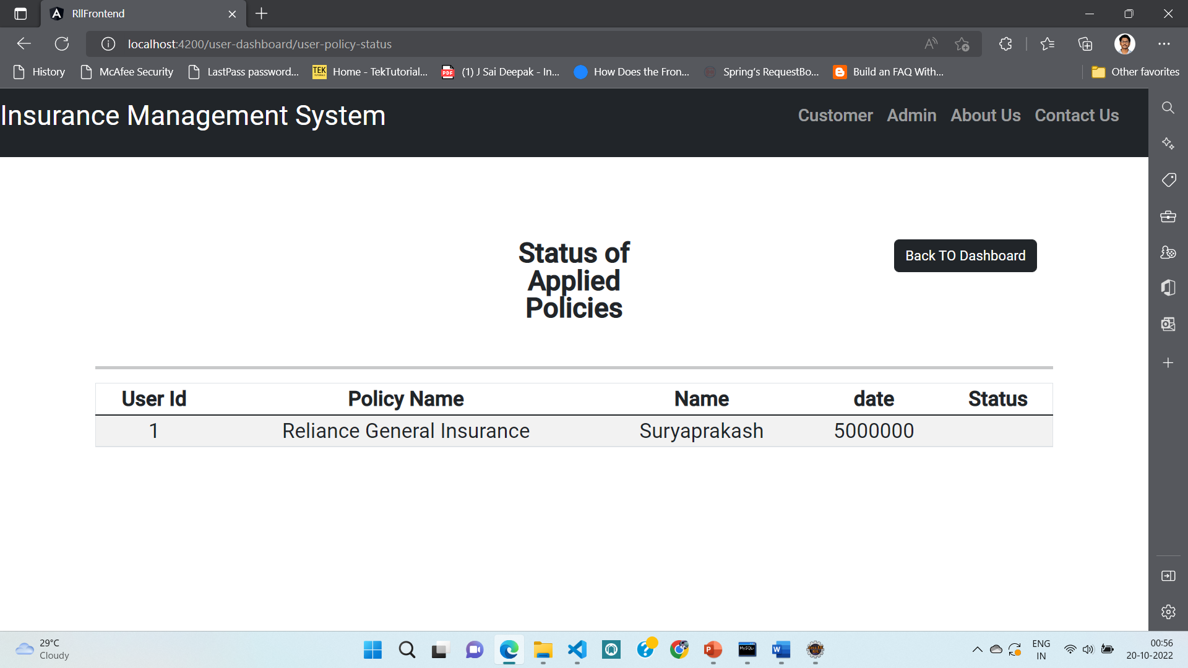
STATUS OF APPLIED POLICIES

Slide 21
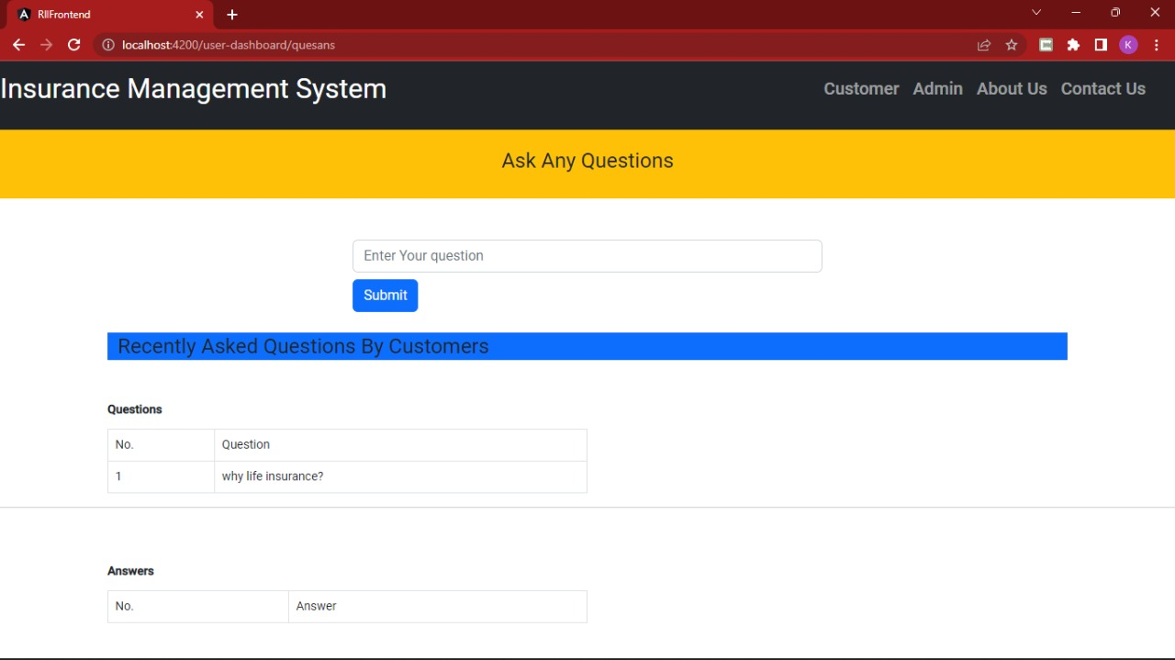
QUESTIONS
In this part , user can ask a question and view the answer posted by the admin.

Slide 22
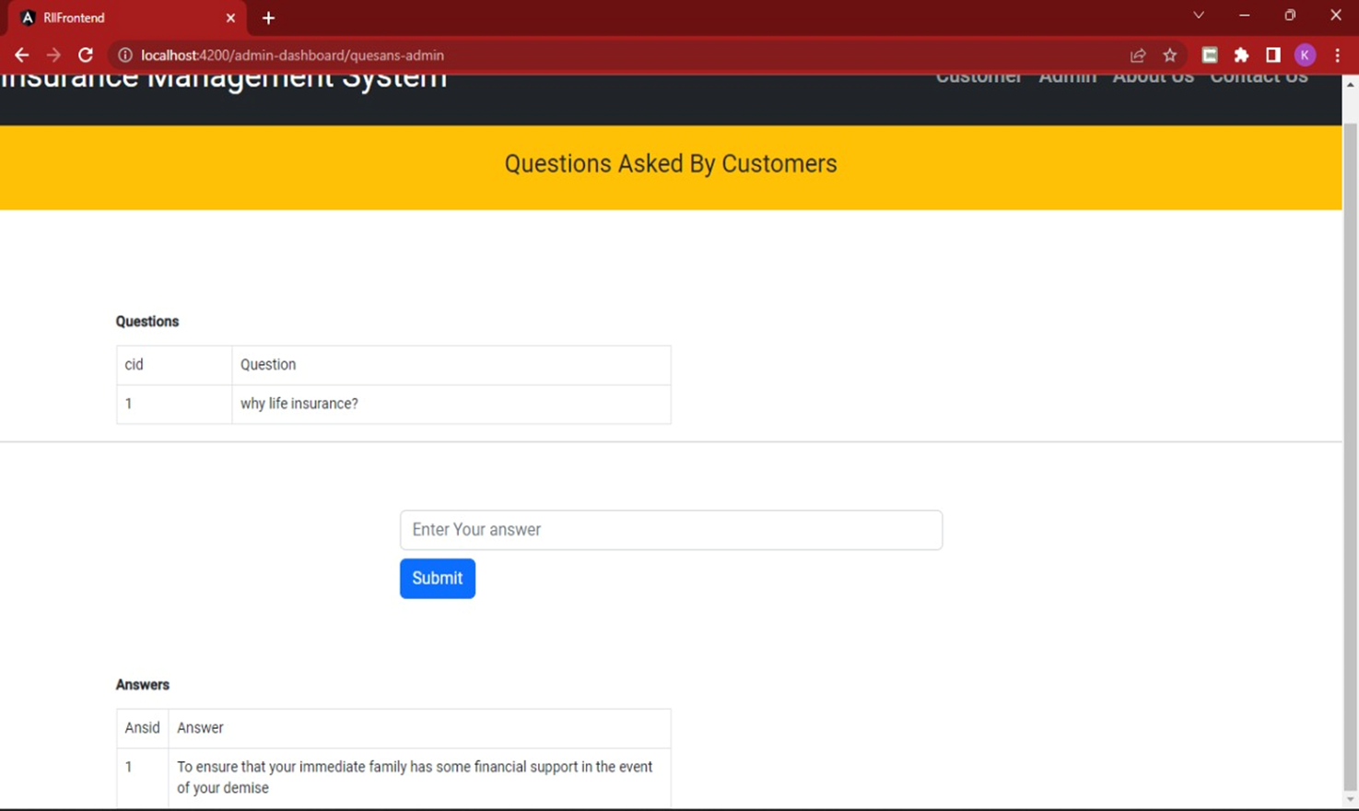
QUESTIONS
In this part admin can view all the questions and respond to those question.

Slide 23

TESTING
Testing is done with:
Selenium
Test NG
Selenium:
Selenium is an open-source tool that automates web browsers. It provides a single interface that lets you write test scripts in programming languages.
Test NG:
TestNG makes automated tests more structured, readable, maintainable and user-friendly.

Slide 24
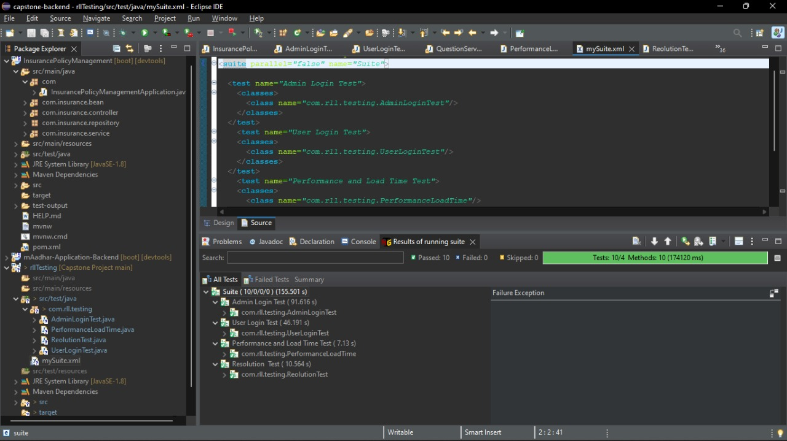
TESTING

Slide 25
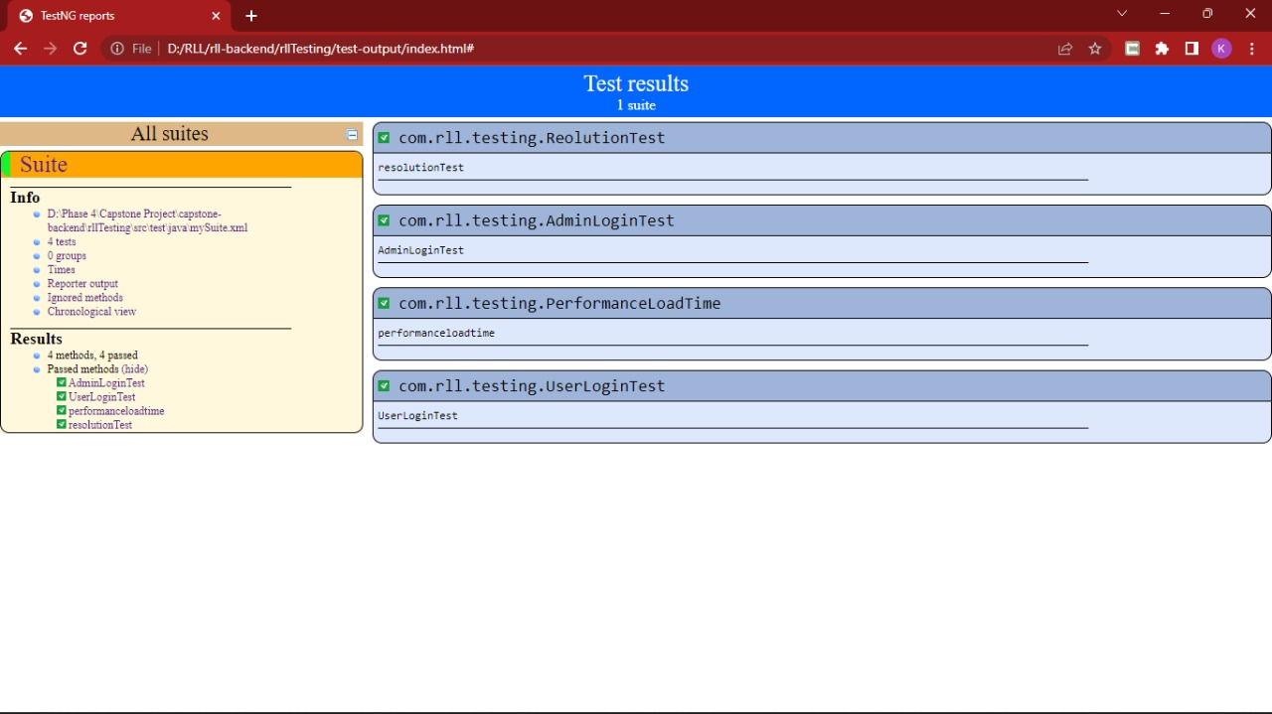
TestNG REPORTS

Slide 26
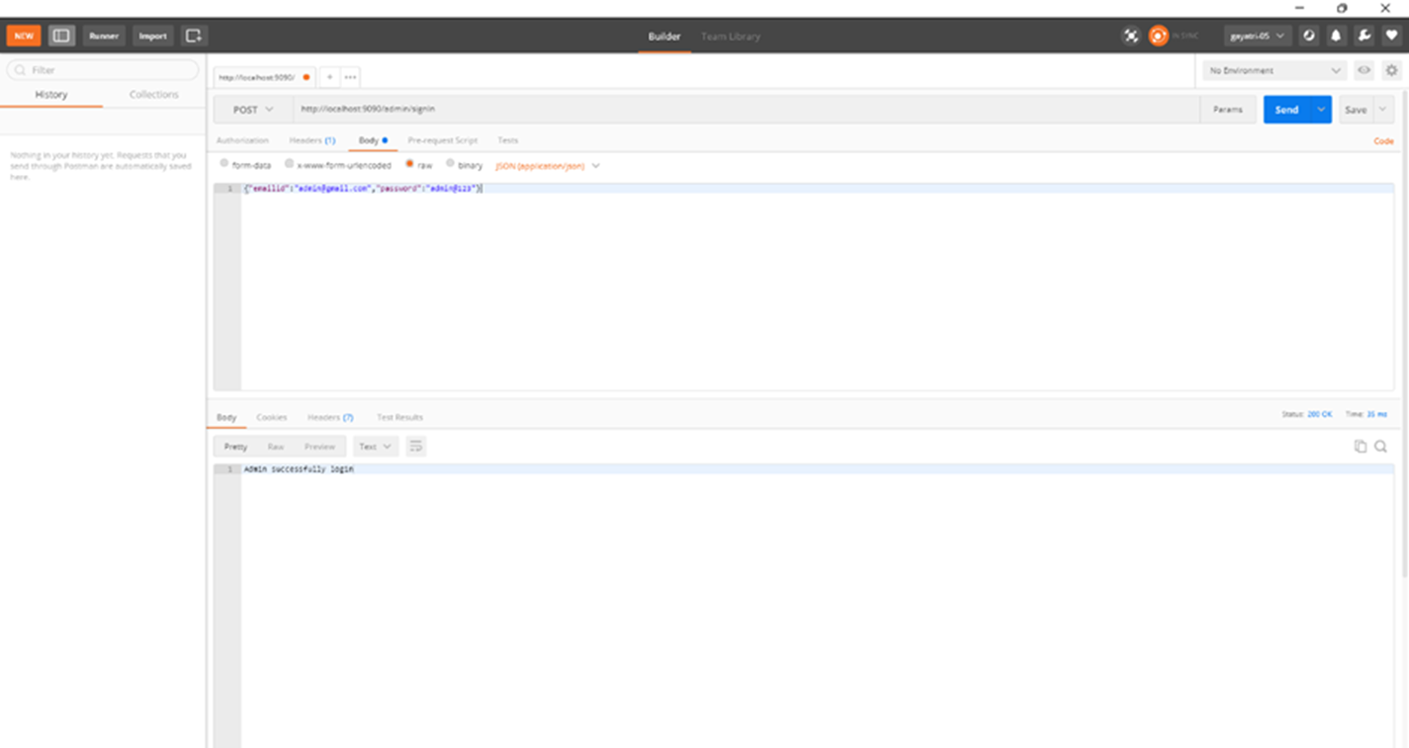
SAMPLE POSTMAN TESTING
1. Example for Post testing method.

Slide 27
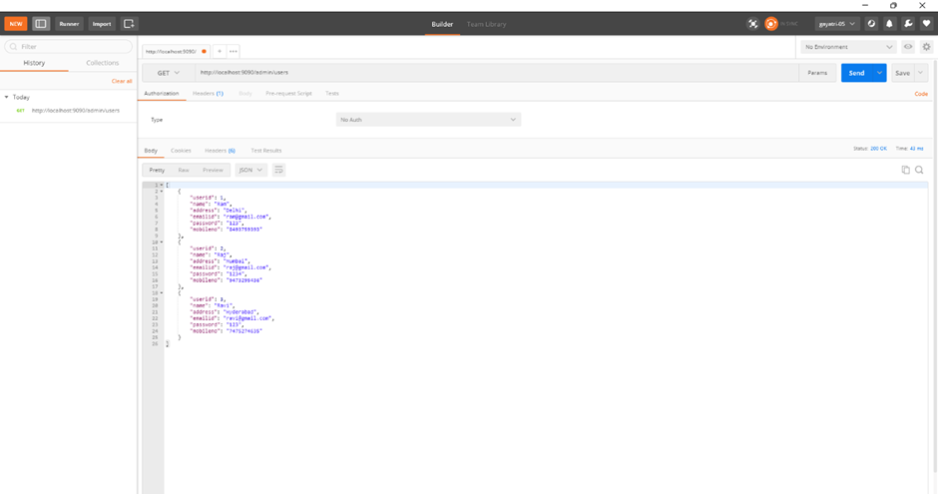
2. Example for GET testing method.

Slide 28
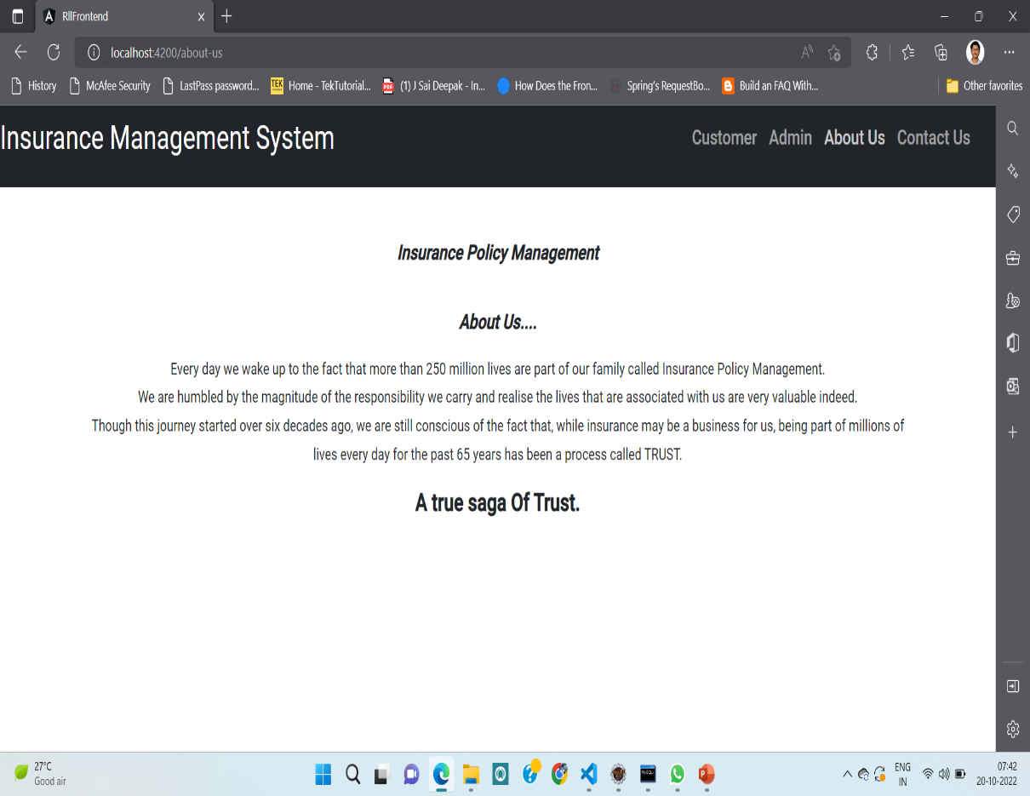
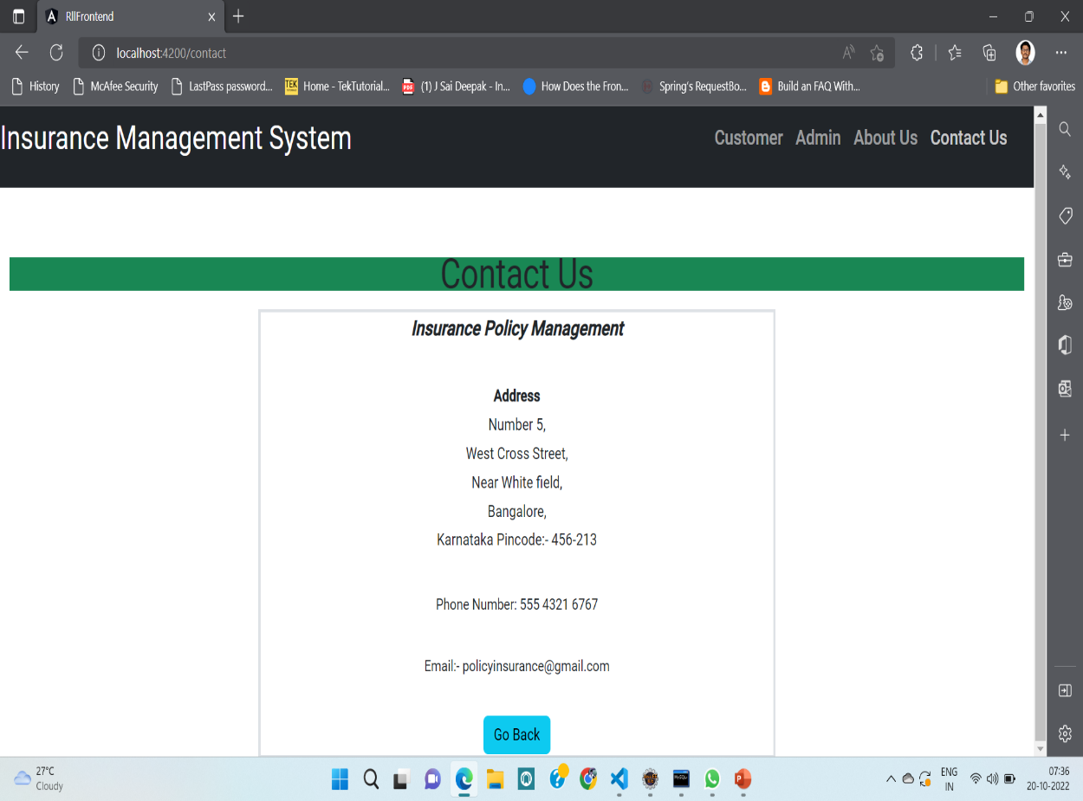
ABOUT US AND CONTACT US
This page shows the information about our insurance policies management.

Slide 29
* In this insurance policy management performing the minimalistic and improved features for user frontend and backend. * It will help to improve admin service and customer service, reduce process costs, streamline the search of applying policies, applied policies approval or not, etc.
CONCLUSION

Slide 30
FUTURE ENHANCEMENT
Keeping track of renewals and avoiding customer churn is another important task for insurance companies.
The renewals management features, carriers can notify policyholders of the impending coverage end date and allow them to renew the policy in a timely manner.
Its still working with manual documentation, it will be quite difficult to keep track of procedures after implementing the program.

Slide 31
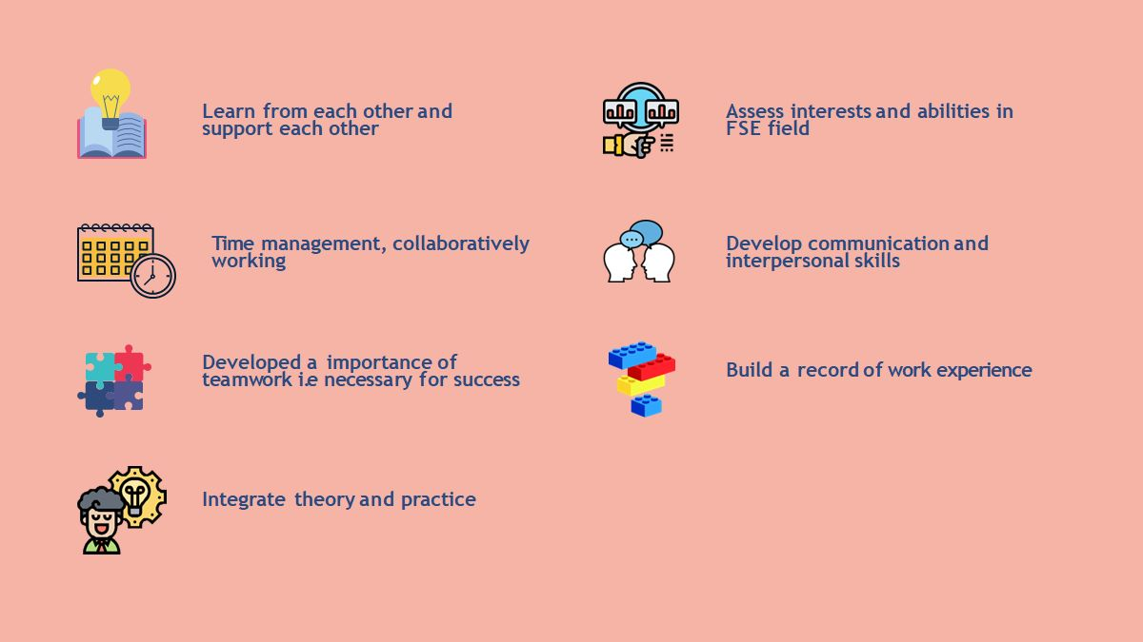

Slide 32


